Slide 1
Splunk: Reports, Statistics, Dashboards and Visualizations
SIEMS Unit, Day 3

Slide 2
Class Objectives
By the end of class today, students will be able to:
Use Splunk’s documentation to implement new search commands.
Generate and use reports from Intrusion Prevention System Logs.
Perform statistical analysis based on even information.
Demonstrate how dashboards are used to accelerate time-to-finish and time-to-action.
Use visualization to compare and aggregate event field data.

Slide 3
Student Activity: Warm-Up Activity
In this activity, you will investigate failed logins using the contingency command.
Instructions sent via Slack.
10 Minutes

Slide 4
Your Turn: Warm-Up Activity
Instructions:
Getting Started
Log into Splunk using your username and password.
Upload the wineventlogs_baseline.csv file into Splunk.
2. Execute a search for failed logins
Next, write a SPL command that will search for failed logins.
3. Investigate the target for the activity
Now write a contingency search command that will display the relationship between account names and account domains. This will narrow down the targets for the failed login attempts.
Hint: pipe the command to your first one.
4. Answer the following question
Where was the attacker trying to gain access?

Slide 5
Warm-Up

Slide 6
Generating Reports in Splunk

Slide 7
Generating Reports in Splunk
Splunk provided many features and functions used to create reports
Reports are created when you save a search. Each report contains the event, field and statistical data that was generated from running the SPL search command.
Reports can be run anytime and they fetch fresh search results each time they are run.
Reports can be scheduled to run at any interval.
Reports show statistics and visualizations and can be used in dashboards.
Reports can be run as historical searches during a security incident investigation.

Slide 8
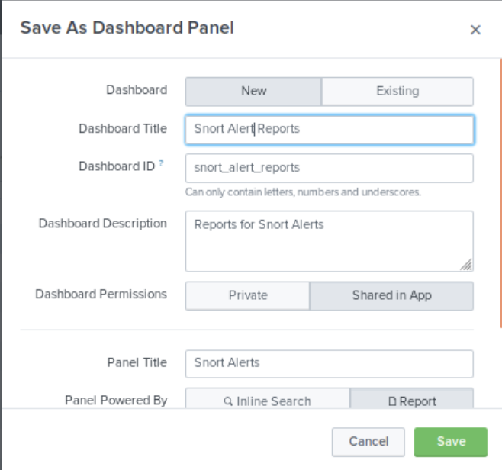
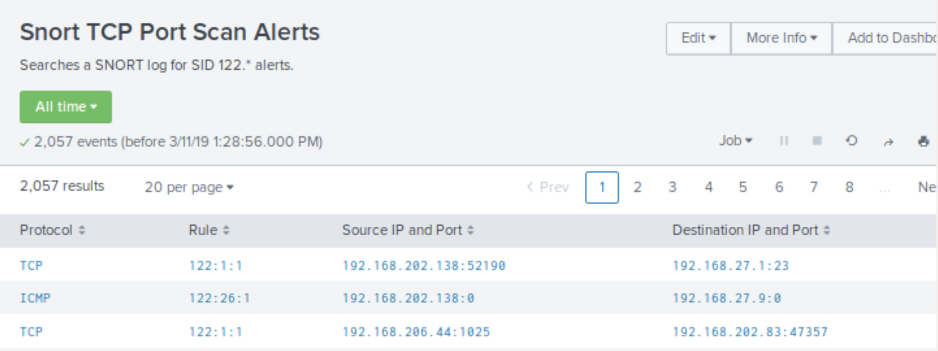
Reports and Dashboards Demo
Now that you’re more familiar with searching in Splunk, the next step is creating reports and dashboards from search results.
Saving a Search as a Report
Adding a Report to a Dashboard
Viewing a Report in a Dashboard
Adding an Existing Search to a Dashboard
Saving the Report to the Snort Alert Dashboard

Slide 9
Generate a Report for Failed Login Attempts

Slide 10
Activity: Generating a Statistical Report from Firewall Attack Logs
In this activity, you will create a statistical report to analyze events from Intrusion PRevention System logs.
Instructions sent via Slack.
20 Minutes

Slide 11
Generating Statistical Report from Firewall Attack Logs

Slide 13
Working with Splunk Dashboards

Slide 14
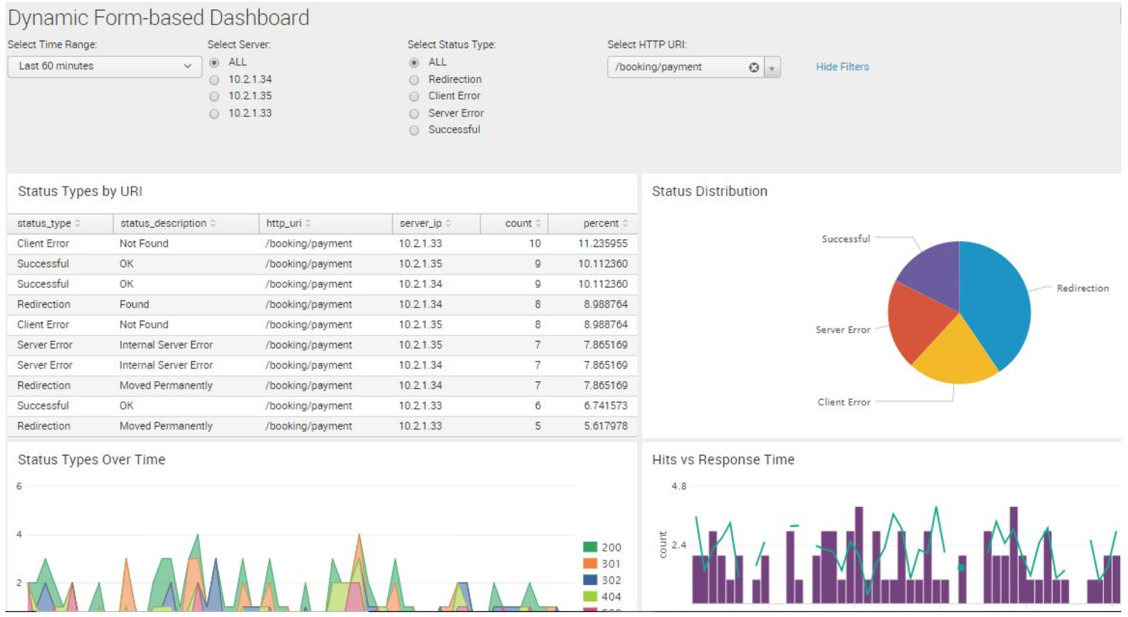
Splunk Dashboards
Dashboards integrate elements in panels to display the most relevant information for different teams and use cases.
Dynamic form-dashboards allow for modifications using radio, vuttons, and check boxes.
Real-time dashboards are displayed on panel
screens for constant viewing in network and
security operations centers.
Dashboards as scheduled reports can be saved
as a PDF file or sent as emails to NOC or SOC
teams at scheduled.

Slide 15
Adding an Existing Search to a Dashboard

Slide 16
Activity: Create a Dashboard for Failed Password Attempts
In this activity, you will create a Failed Password Dashboard for Monitoring login attempts on Linux and Windows system for a SOC Team.
Instructions sent via Slack.
15 Minutes

Slide 17
Create a Dashboard for Failed Password Attempts

Slide 18
Visualizations

Slide 19
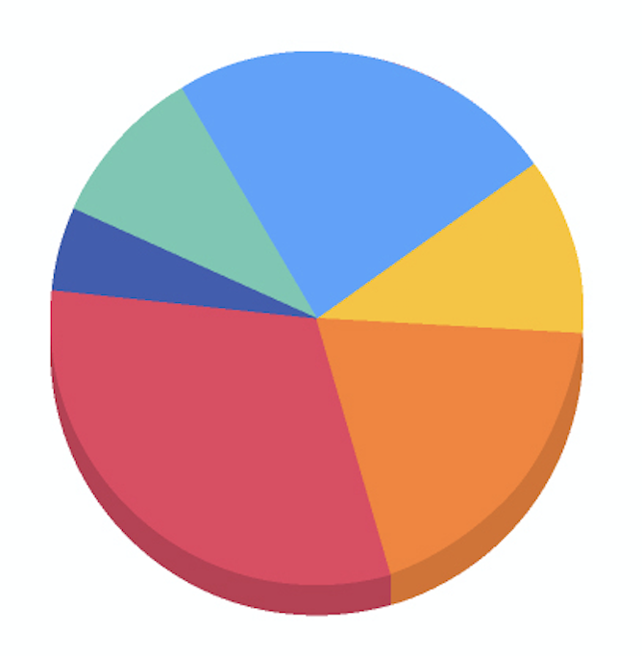
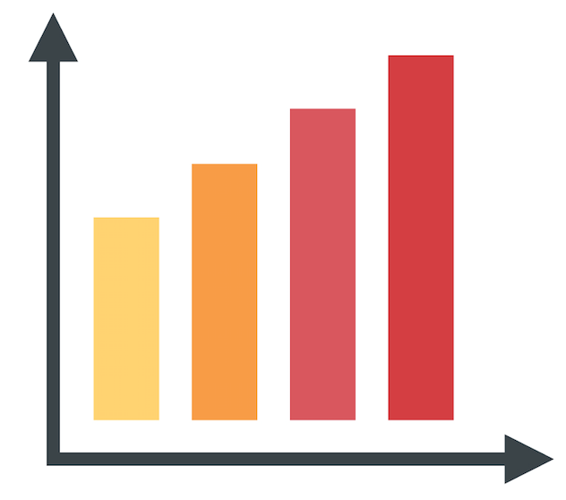
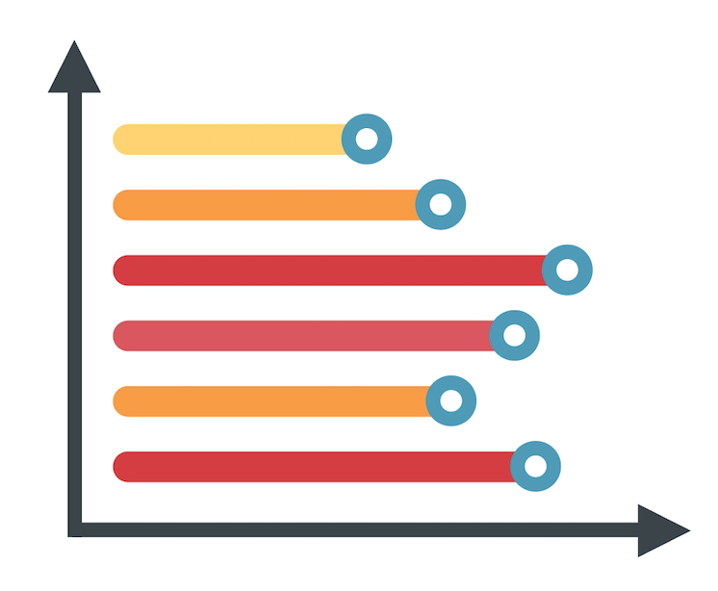
Visualization in Splunk
Splunk provides many visual data representation tools.
Filler Gauge
Pie Charts
Bar Charts
Radial Gauge
Bubble Charts
Geographic Maps
And Many More...

Slide 20
Visualizing Data from Firewall Attack Logs

Slide 21
Student Activity: Visualizing Data From Firewall Attack Logs
In this activity, you will continue working on the Fortinet Firewall Research project
Instructions sent via Slack.
15 Minutes

Slide 22
Visualizing Data from Firewall Attack Logs

Slide 23
Class Objectives
By the end of class today, students will be able to:
Use Splunk’s documentation to implement new search commands.
Generate and use reports from Intrusion Prevention System Logs.
Perform statistical analysis based on even information.
Demonstrate how dashboards are used to accelerate time-to-finish and time-to-action.
Use visualization to compare and aggregate event field data.

Slide 24

Any Questions?

